Slide 1

WHAT IS
BEST VISUAL IDENTITY
AND HOW TO USE IT

Slide 2

WHAT IS
BEST VISUAL IDENTITY
?

Slide 3

PART ONE
ABOUT BEST.

Slide 4
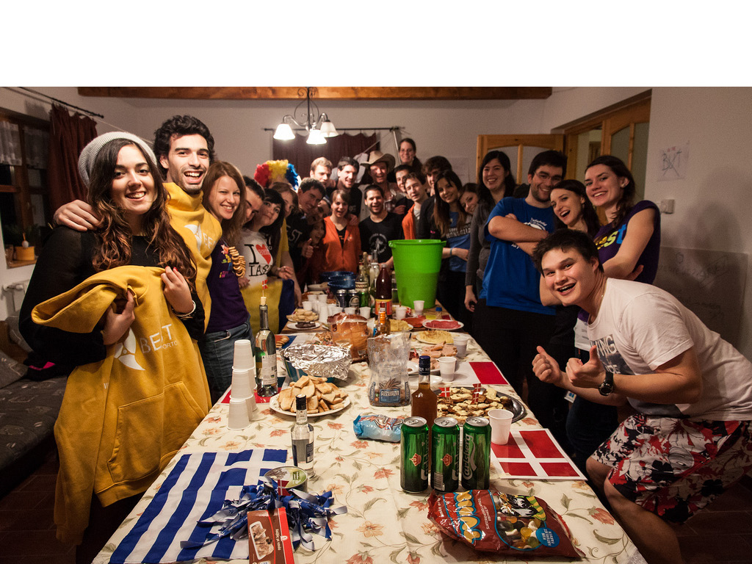
WE ARE COMING FROM DIFFERENT PARTS OF EUROPE

Slide 5
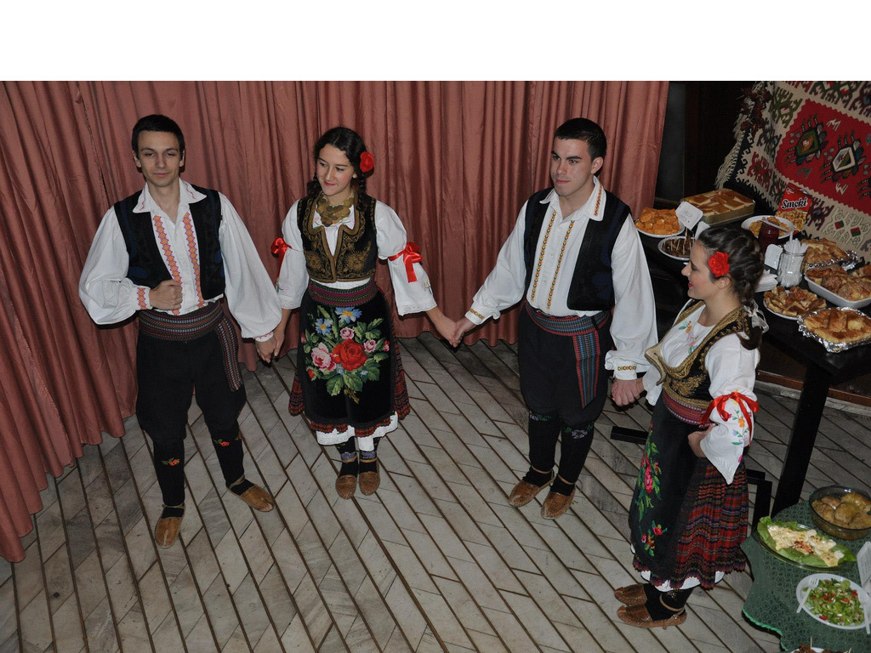
FROM DIFFERENT BACKGROUND

Slide 6
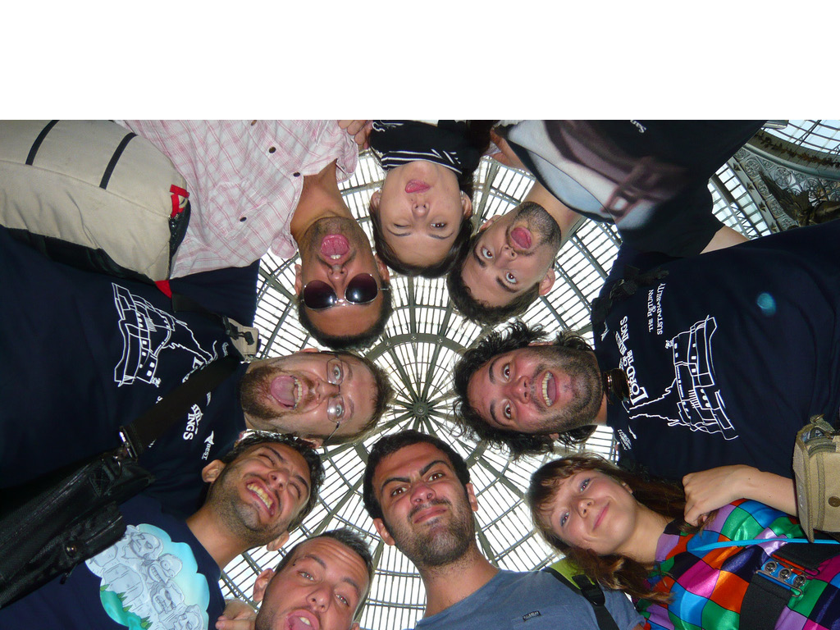
BUT WE ARE TRYING TO CREATE SOMETHING TOGETHER

Slide 7
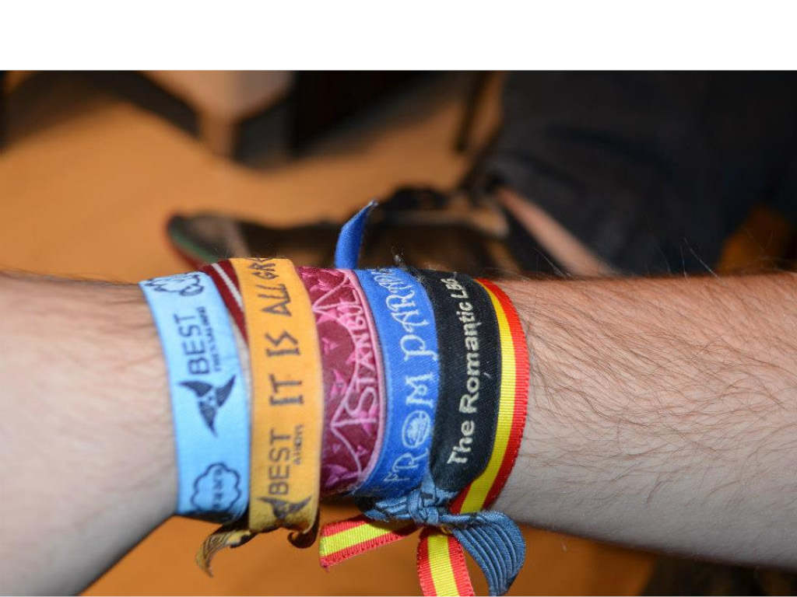
WE JOINED FOR DIFFERENT REASONS

Slide 8
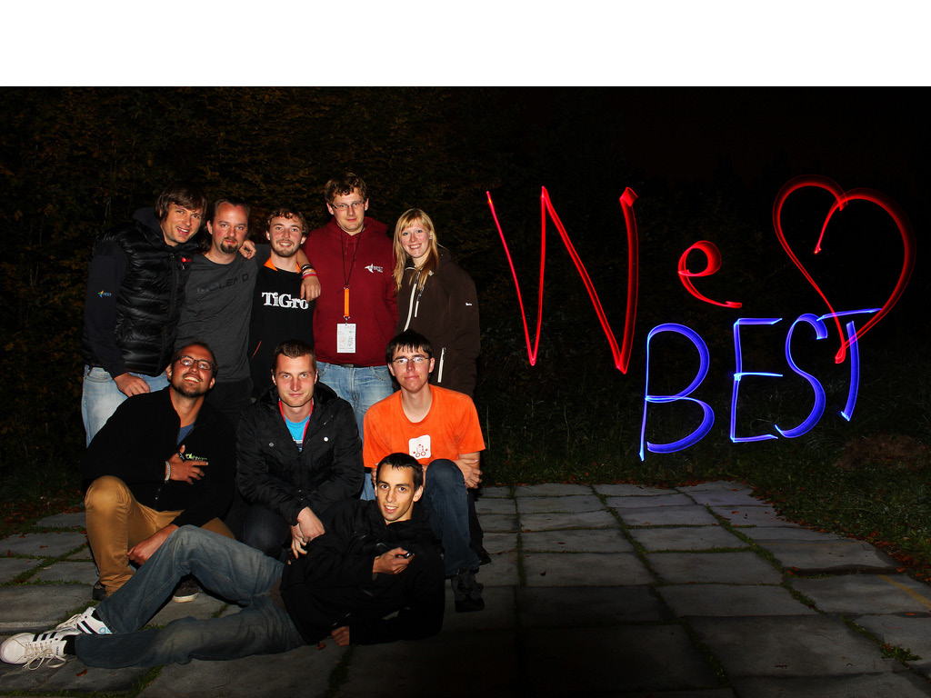
AND STAYED FOR ONE

Slide 9
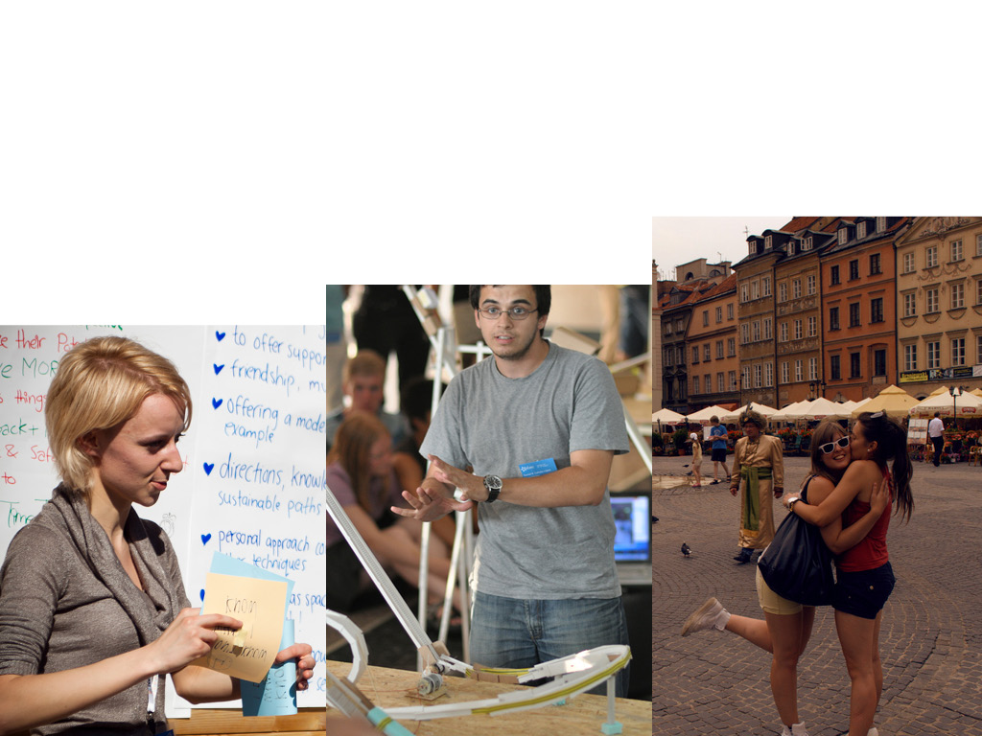
WE BELIEVE IN SOMETHING COMMON, WE SHARE IDEAS, AND WE BECOME A PART OF A BIGGER WHOLE, WHICH NEEDS A NAME.

Slide 10
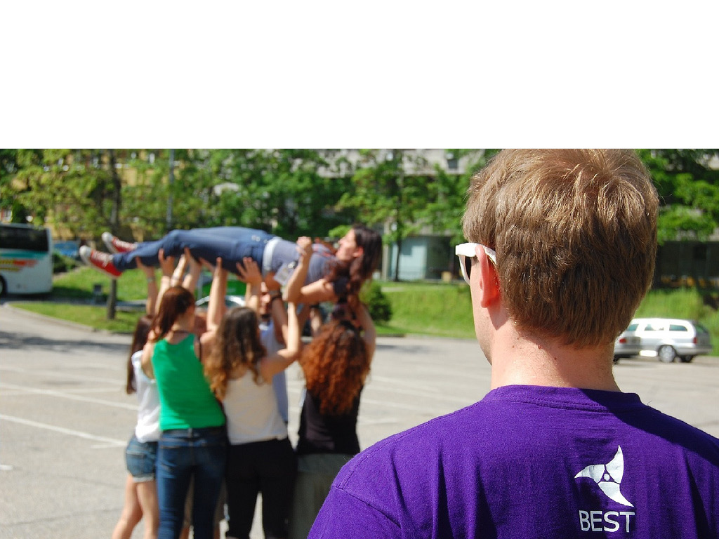
THAT’S WHY WE ARE BEST, AND WE SHARE COMMON VALUES, OTHERWISE WE WOULD GO IN DIFFERENT DIRECTIONS AND NEVER BE ABLE TO DO SOMETHING.

Slide 11
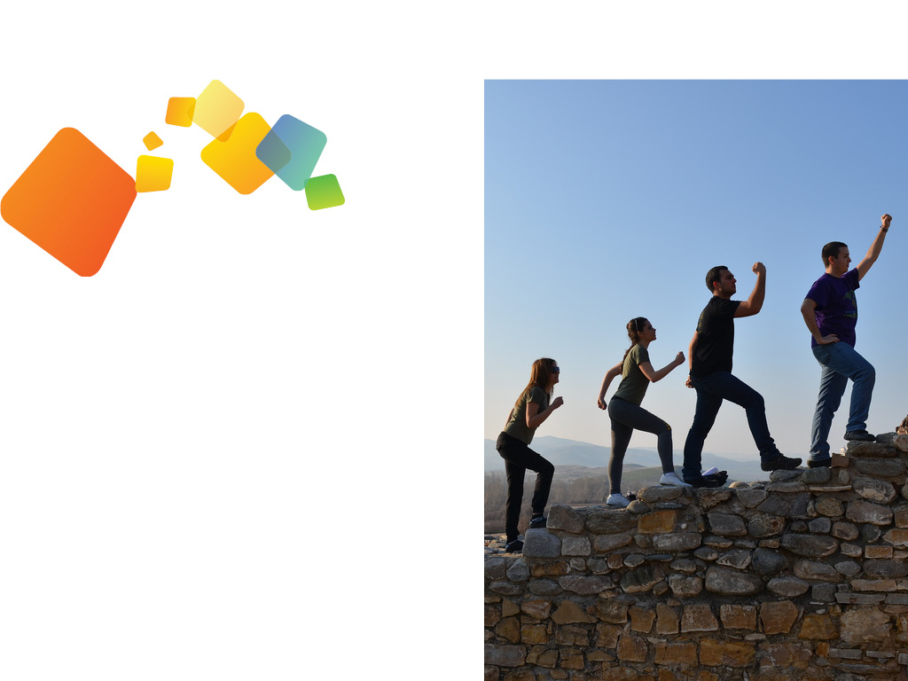
TO KNOW WHERE WE ARE GOING, WE DEFINE OUR
VISION
EMPOWERED DIVERSITY
PEOPLE UNDERSTAND AND RESPECT DIFFERENT CULTURES AND SOCIETIES. AN ENVIROMENT OF EMPOWERED DIVERSITY SUPPORTS PEOPLE IN TO APPLY THEIR FULL POTENTIAL AND TO ACT RESPONSIBLY.

Slide 12
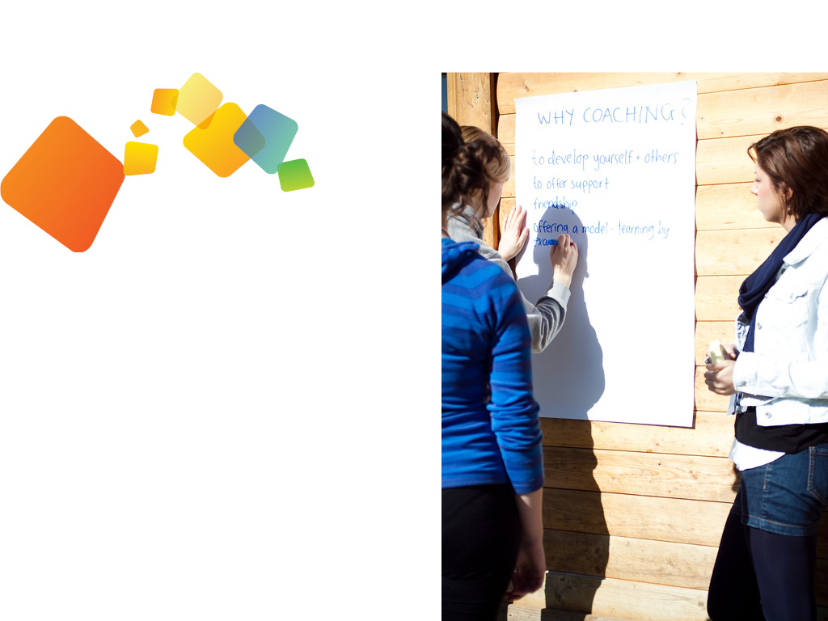
TO KNOW WHERE WE ARE GOING, WE DEFINE OUR
MISSION
DEVELOPING STUDENTS
BEST HELPS STUDENTS TO ACHIEVE AN INTERNATIONAL MINDSET, TO REACH A BETTER UNDERSTANDING OF CULTURES AND SOCIETIES AND TO DEVELOP THE CAPACITY TO WORK IN CULTURALLY DIVERSE ENVIROMENTS.

Slide 13
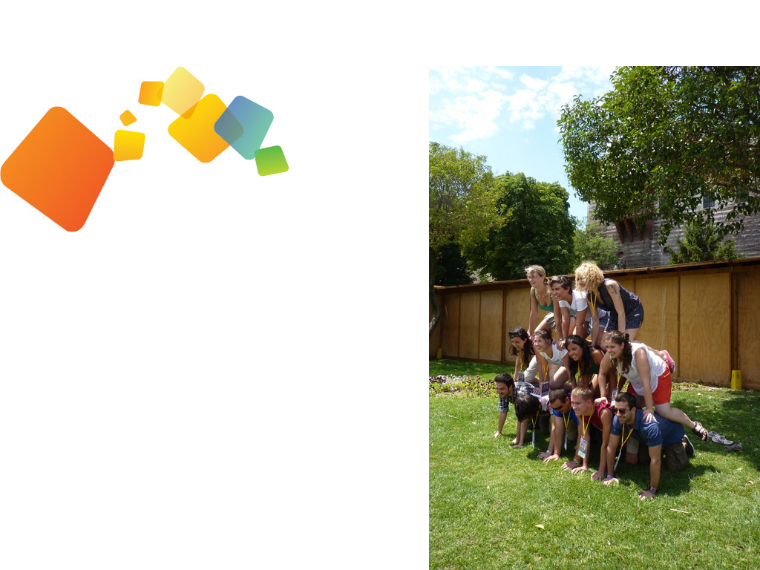
TO KNOW WHERE WE ARE GOING, WE DEFINE OUR
BEST SPIRIT
FLEXIBILITY
WE SEEK THE ABILITY TO MAKE CHANGES AND TO DEAL WITH CHANGING CONDITIONS. WE ARE OPEN TO EVERYTHING NEW. WE VALUE AND NURTURE THE ABILITY OF BEING MOBILE AND TO QUICKLY RESPOND TO CHANGES IN THE ENVIROMENT OR TO ANY OTHER OBSTACLE THAT WE FACE.

Slide 14
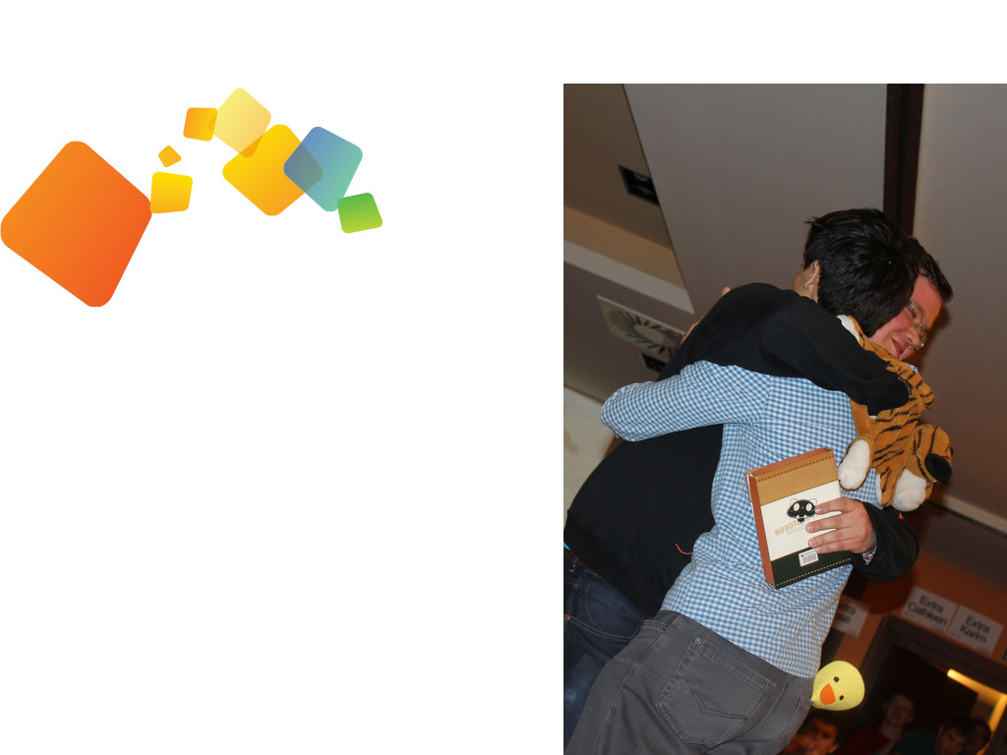
TO KNOW WHERE WE ARE GOING, WE DEFINE OUR
BEST SPIRIT
FRIENDSHIP
WE BUILD GOOD RELATIONSHIPS WHERE PEOPLE HELP, SUPPORT AND CARE FOR ONE ANOTHER. WE VALUE GOOD PERSONAL RELATIONS AND TEAMWORK.
WE FOCUS ON EACH PERSON INVOLVED IN OUR ACTIVITIES AND IN THIS WAY WE CREATE SYNERGY.

Slide 15
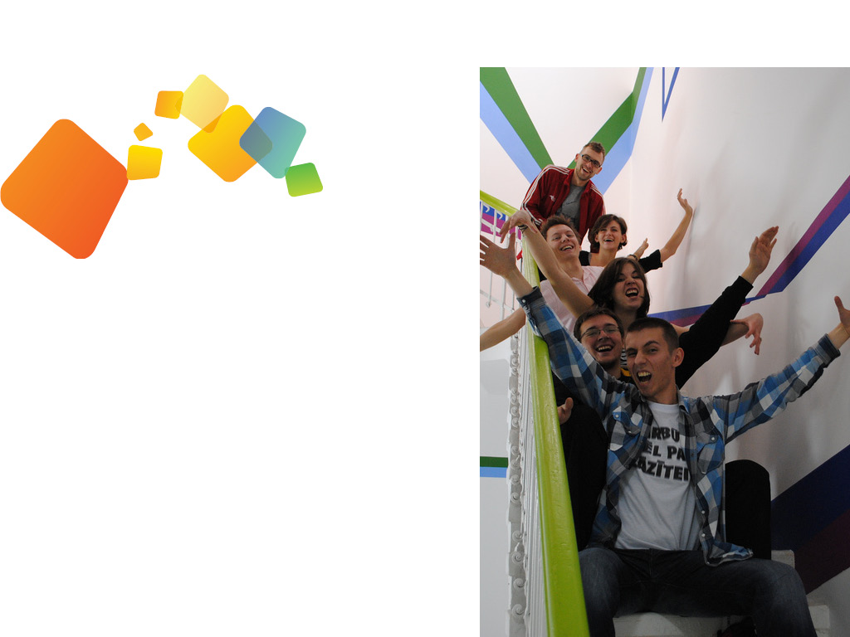
TO KNOW WHERE WE ARE GOING, WE DEFINE OUR
BEST SPIRIT
FUN
WE ENJOY EVERYTHING WE DO. WE VALUE THE POSITIVE EMOTIONS OF THE PEOPLE INVOLVED IN OUR ACTIONS. WE STRIVE TO MAKE OUR ACTIVITIES ENJOYABLE FOR EVERYBODY WHO IS CONNECTED TO THEM. WE ACT WITH PASSION AND STRIVE TO SHARE THIS PASSION WITH THE PEOPLE AROUND US.

Slide 16
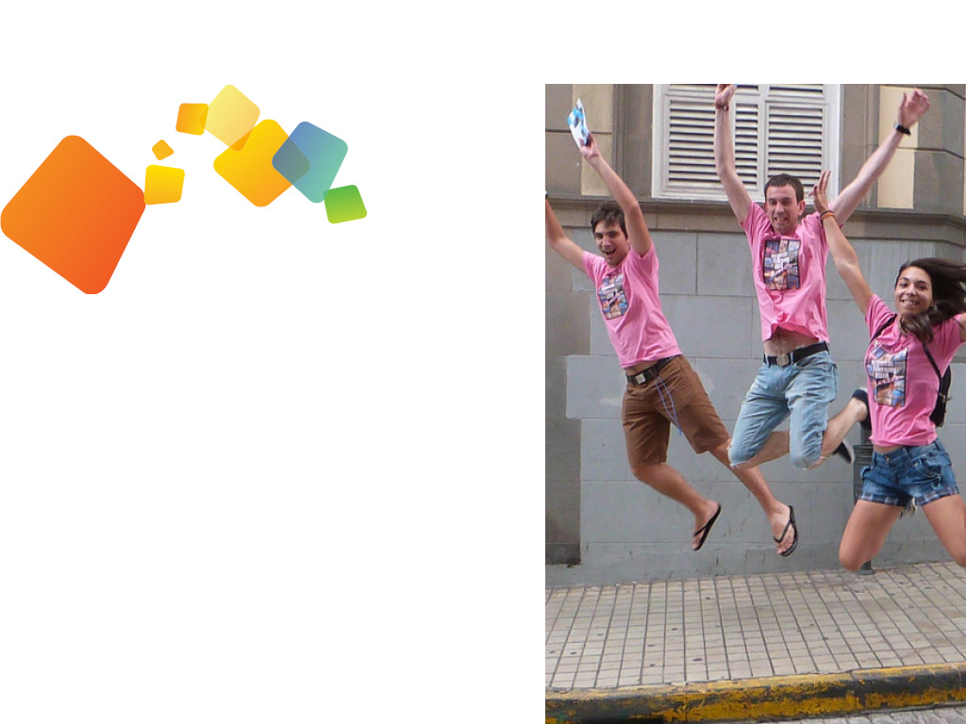
TO KNOW WHERE WE ARE GOING, WE DEFINE OUR
BEST SPIRIT
IMPROVEMENT
WE STRIVE TO CONTINUOUSLY IMPROVE THE STANDARDS OF EVERYTHING WE DO. WE USE ALL OUR CREATIVITY TO ENHANCE THE WAY WE WORK. THIS IS TO GUARANTEE THE CONSTANT DEVELOPMENT OF OUR ACTIONS.

Slide 17
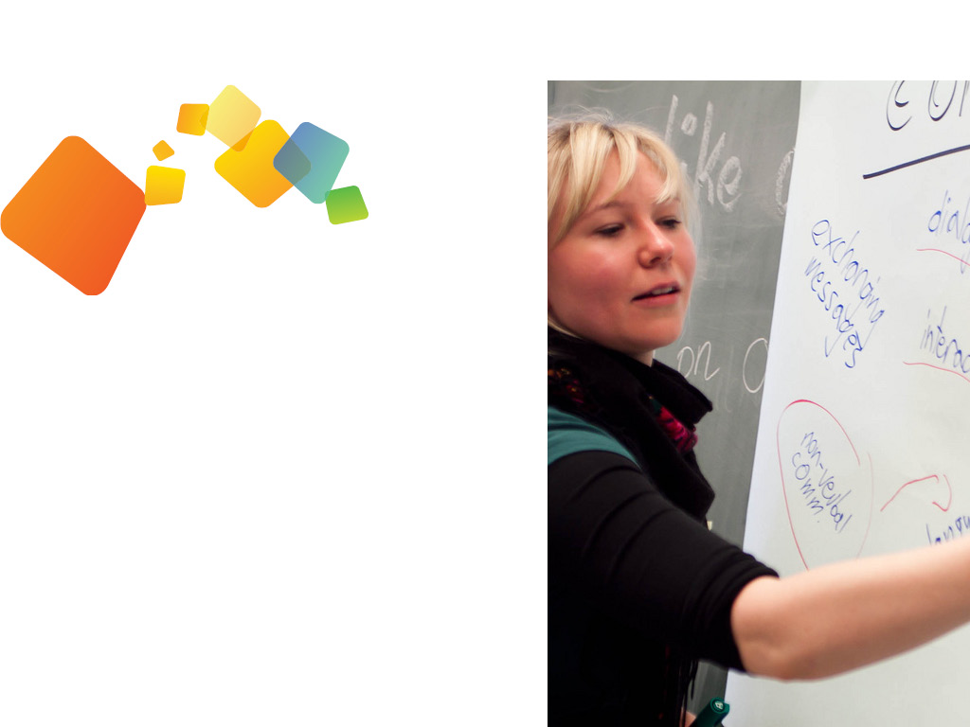
TO KNOW WHERE WE ARE GOING, WE DEFINE OUR
BEST SPIRIT
LEARNING
WE GAIN SKILLS AND UNDERSTANDING THROUGH EXPERIENCE. WE VALUE EVERYTHING WE LEARN THROUGH THE EXPERIENCE OF BEING INVOLVED IN OUR ACTIVITIES AND WE STRIVE TO LEARN AS MUCH AS POSSIBLE FROM EVERY ASPECT OF OUR WORK.

Slide 18
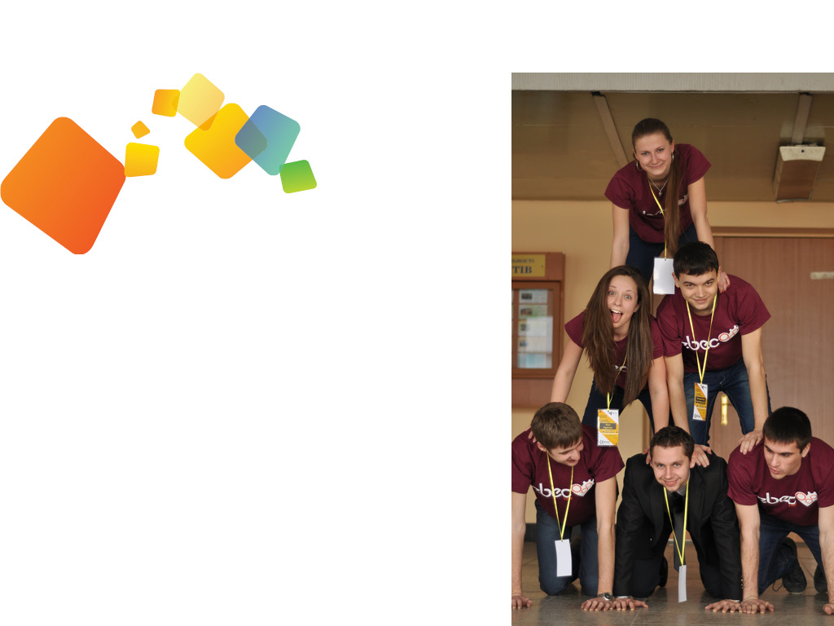
TO KNOW WHERE WE ARE GOING, WE DEFINE OUR
POSITION
BEST IS A VOLUNTARY, APOLITICAL, NON-PROFIT, AND NON-REPRESENTATIVE INTERNATIONAL ASSOCIATION OF EUROPEAN STUDENTS OF TECHNOLOGY.
WE DO EVERYTHING OUT OF FREE WILL. WE ARE POLITICALLY NEUTRAL. WE ATTEMPT TO MAKE NO PROFIT FROM OUR ACTIONS. WE REPRESENT NO ONE. WE ARE BASED N EUROPE. WE ARE THERE FOR EUROPEAN STUDENTS OF TECHNOLOGY.

Slide 19
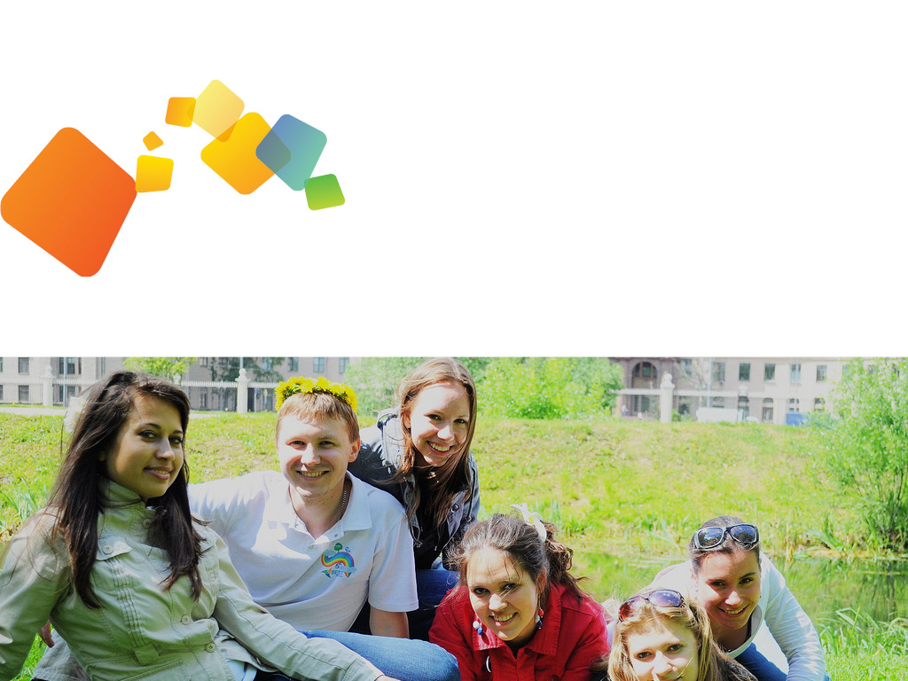
TO KNOW WHERE WE ARE GOING, WE DEFINE OUR
STAKEHOLDERS
STUDENTS
EUROPEAN STUDENTS OF TECHNOLOGY.

Slide 20
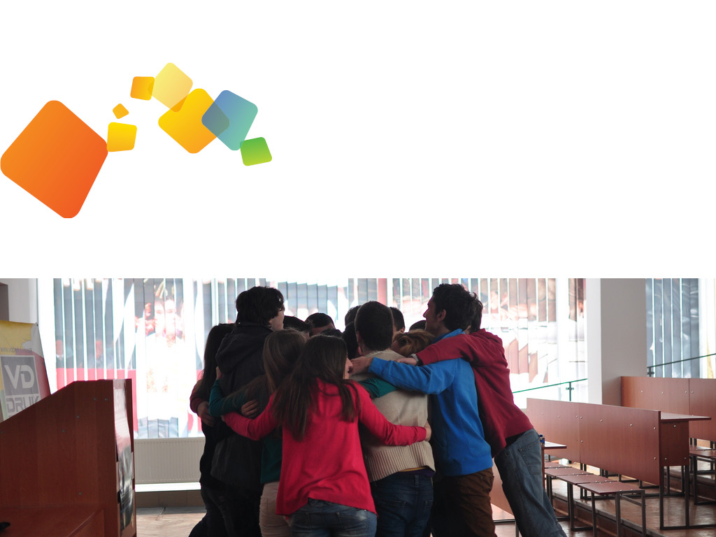
TO KNOW WHERE WE ARE GOING, WE DEFINE OUR
STAKEHOLDERS
UNIVERSTIES
EUROPEAN UNIVERSITIES.

Slide 21
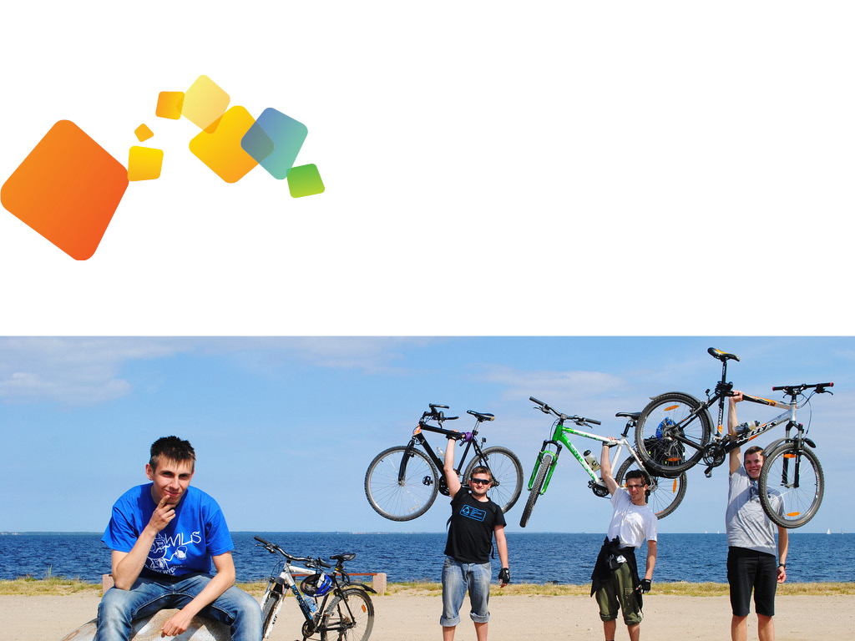
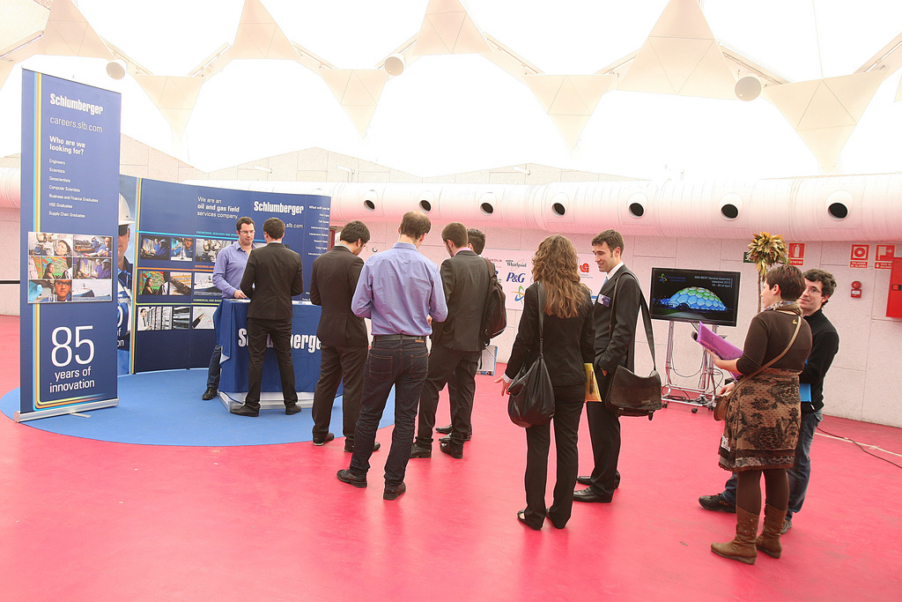
TO KNOW WHERE WE ARE GOING, WE DEFINE OUR
STAKEHOLDERS
PARTNERS
ORGANISATIONS AND INDIVIDUALS WE COOPERATE WITH.

Slide 22
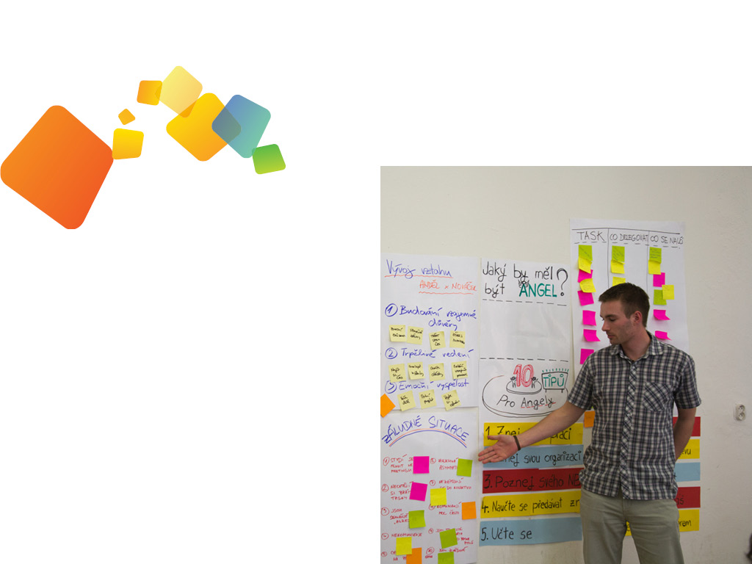
TO KNOW WHERE WE ARE GOING, WE DEFINE OUR
ACTIVITIES
CORE ACTIVITY
PROVIDING COMPLEMENTARY EDUCATION.
BRIINGING SIGNIFICANT ADDED VALUE TO THE EDUCATION PROVIDED BY UNIVERSITIES.

Slide 23
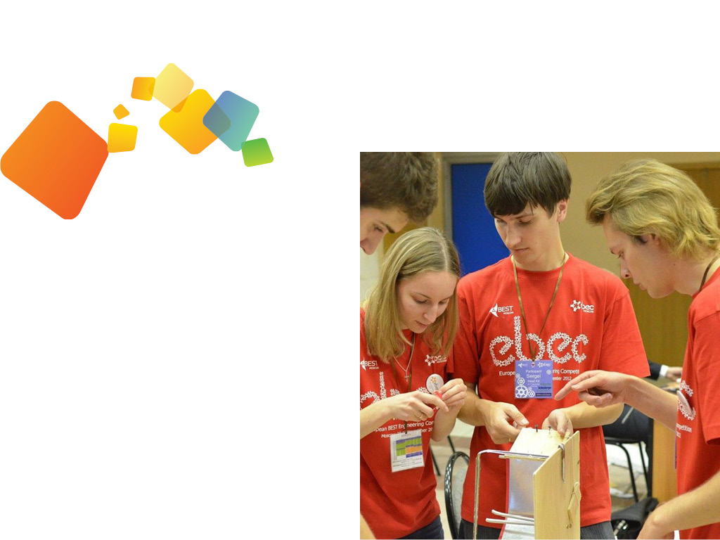
TO KNOW WHERE WE ARE GOING, WE DEFINE OUR
ACTIVITIES
OTHER ACTIVITIES
INCREASING EDUCATIONAL INVOLVEMENT.

Slide 24
PART TWO
DESIGN.

Slide 25


PART TWO
BEST LOGO
SYMBOLISING EMPOWERED DIVERSITY
THE LOGOMARK REPRESENTS THREEE PEOPLE COMING TOGETHER FROM 3 DIFFERENT DIRECTIONS AND PUTTING THER HEADS TOGETHER. THIS IS THE WAY WE WORK: ARRIVING FROM DIFFERENT BACKGROUNDS AND WORKNG TOGETHER IN ORDER TO ACHIEVE GREAT THINGS.

Slide 26
PART TWO
BEST LOGO
SYMBOLISING DEVELOPING STUDENTS
The three arms of the BEST logo start at the edge before pinwheeling towards the centre. As they spiral inwards, they grow and develop - symbolising the growth and development of the skills and knowledge of the students that form the soul of BEST.

Slide 27
PART TWO
BEST LOGO
SYMBOLISING DEVELOPING STUDENTS
The three colours represent the stakeholders which are brought together through BEST.

Slide 28
PART TWO
BEST LOGO
SYMBOLISING CONTINUITY AND DYNAMISM
The twisted elements of the logomark express rotation which symbolises BEST as a dynamic organisation that is continuously developing itself.

Slide 29



LOGO
VARIATIONS

Slide 30
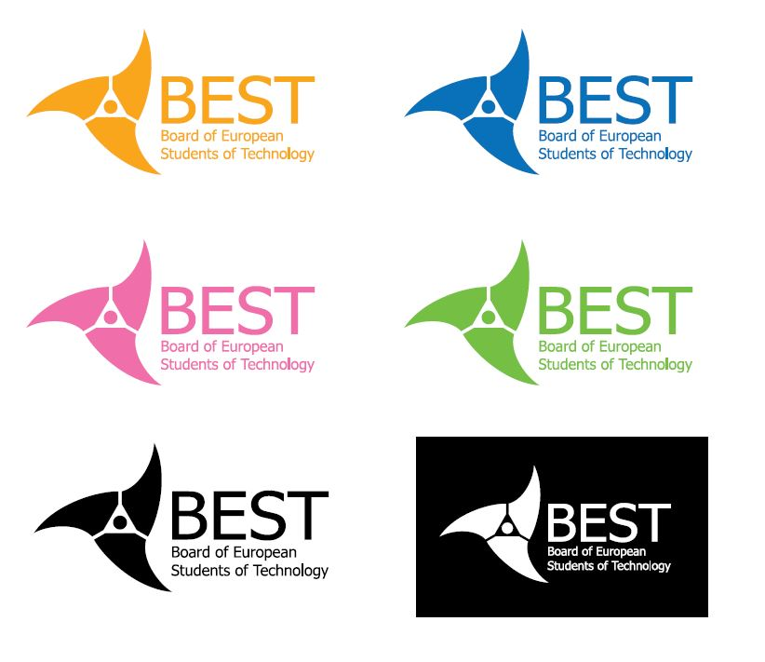
LOGO
COLOUR
Notes:
The primary logo uses the 3 colours for the logomark and the blue for the logotype. It can be used on any background as long as the background does not affect the visibility of the logo.
In black and white, the logo has to be in contrast in order to ensure good visibility. A grayscale version is forbidden for use since it always has inferior visibility compared to a full black and white version.
Single coloured versions can be used also as long as the background is not affecting the visibility of the logo.
When using the single coloured version, it is strongly recommended to use them in one of the three official BEST colours.

Slide 31



TRANSPARENCY
PORTIONS OF THE LOGOMARK
LOGOMARK
BEST STAR
ROTATION

Slide 32



INCORRECT USAGE
LOGOMARK
BEST STAR

Slide 33
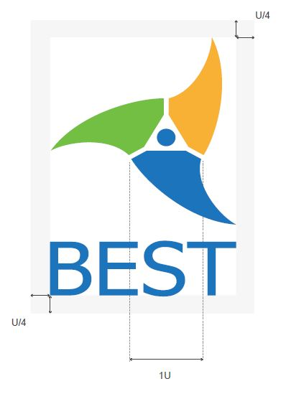
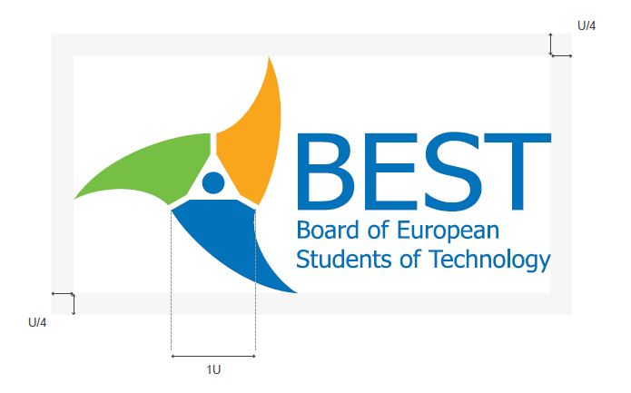
LOGO
SAFE SPACE
Notes:
The ‘safe space‘ defines the minimum area that must be left clear around the logo, and ensures that the logo is never overshadowed by other text or visual elements.
The size of the safe space helps to ensure clarity and improve impact. No text or graphics should appear within this boundary unless they are used as light background elements.

Slide 34




UNACCEPTABLE
USES

Slide 35

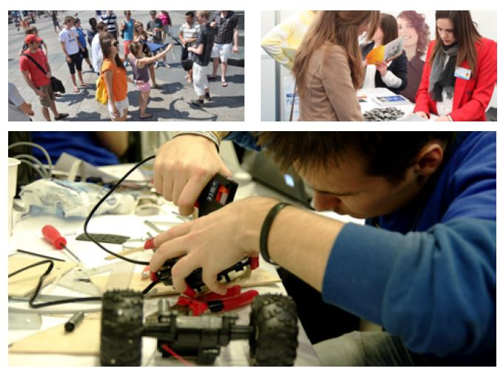
www.flickr.com/photos/bestorg/

Slide 36
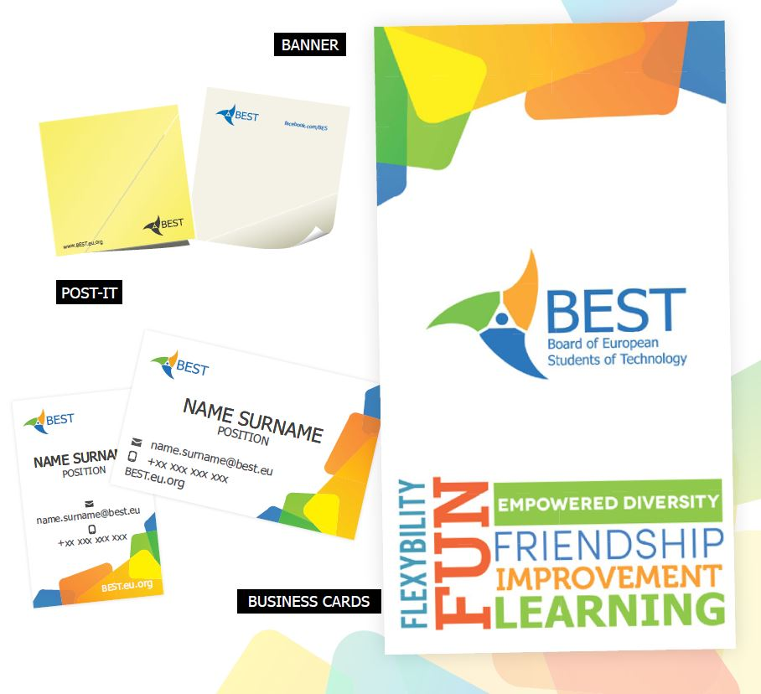
TEMPLATES

Slide 37
QUESTIONS
?

